Slide 1
MIGRATION OF SERVICE AT RUNTIME IN CLUSTER
Team Members :
1.Shivam Somani
2.Sibin Thomas
3.Sonalika Achale
4.Srajan Gupta
5.Neha Morya
Guided by:- Prof. D. A. Mehta
Nikita Tiwari Ma’am

Slide 2
Our Objective:
To speed up the process of instance migration by just migrating container and not the whole virtual machine. Which will further help in efficient bandwidth usage and less wastage of memory resources.

Slide 3
Outline
Introduction
Motivation
Background Study
Challenges
Real life advantages
References

Slide 4
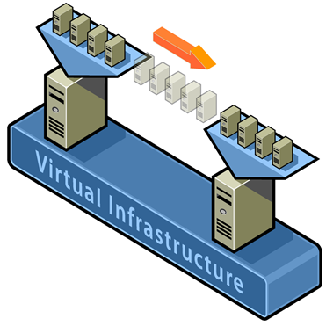
Introduction
What’s live migration?
Live migration means moving instances across different hosts with little or no downtime for running services.
User of Services are unaware of the migration.
Services are seamlessly resumed from the same instance as before migration .

Slide 5
Motivation
Live migration can be a extremely powerful tool for cluster administrators.
Hardware / Software maintenance / upgrades
Load balancing / resource management
Distributed power management

Slide 6
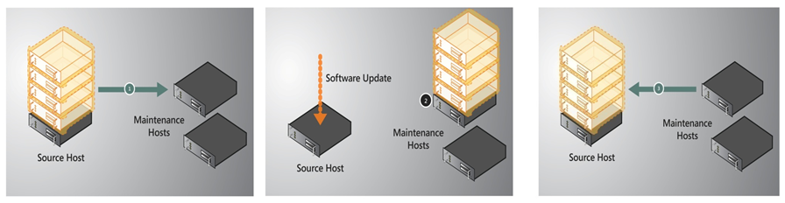
Scenario 1: Host servicing / Hardware Maintenance
Live Migrate Containers from Source to Destination
Hardware Servicing, no downtime seen by services on Destination
Live Migrate containers from back from Destination to Source

Slide 7
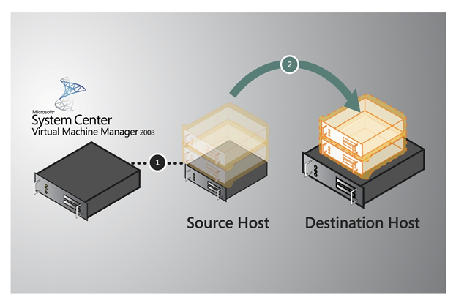
Scenario 2: Load Balancing
Load Balancer can move containers at run time for balancing the load among nodes.

Slide 8
Background Study
Earlier the Migration of services has been achieved using the Virtual Machine.
VM is a guest OS which provides isolation from host and host can emulate different operating system and hardware platforms with it.
VM migration uses shared memory storage to take care of file dependencies.
VM Live migration basically follows this steps-
Pre-migration
Reservation
Iterative pre-copy
Stop and copy
Commitment
Activation

Slide 9
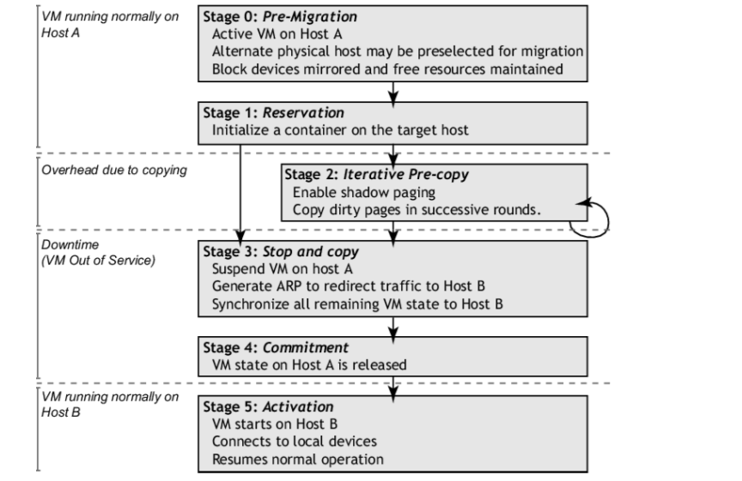

Slide 10
What is a Container ?
Containers are packages that rely on virtual isolation to deploy and run applications that access a shared operating system (OS) kernel without the need for virtual machines (VMs).
Containers hold the components necessary to run desired software. These components include files, environment variables, dependencies and libraries.

Slide 11
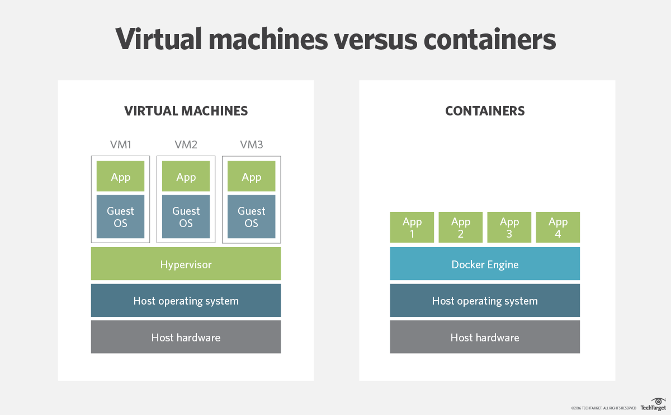

Slide 12
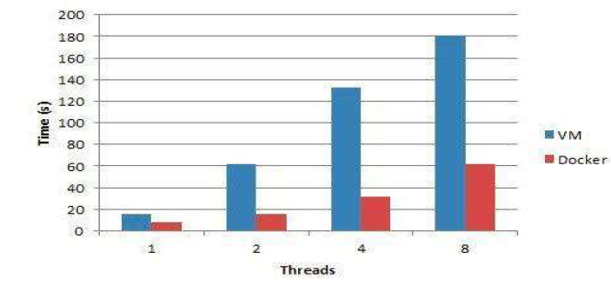
Drawbacks of virtual machine based migration
Latency Time

Slide 13
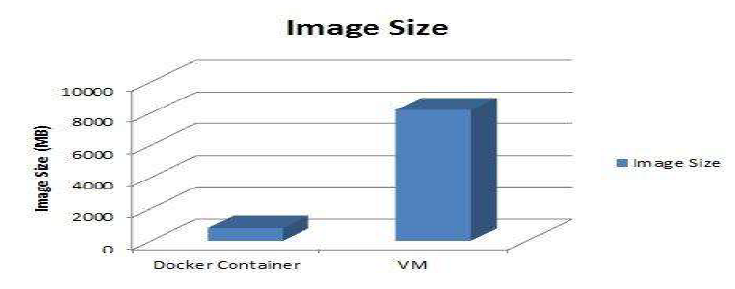

Slide 14
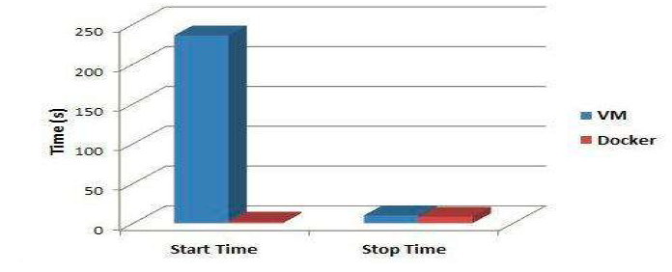
Boot Time

Slide 15
CRIU a useful tool
Checkpoint/Restore In Userspace, or CRIU is a software tool for the Linux operating system. Using this tool, you can freeze a running application (or part of it) and checkpoint it as a collection of files on disk. You can then use the files to restore the application and run it exactly as it was during the time of the freeze.
But, There are a few ongoing attempts to develop a proper method for migration of services at runtime using docker container and CRIU freeze technology but no one has been able to develop a full fledged globally acceptable solution for migration a service keeping in mind that all it’s dependencies are successfully resolved .

Slide 16
Challenges
Moving container from one host to another host at run time.
Resuming service with no or very low downtime, user of service even can’t notice.
Its challenging to preserve all dependencies of service and restore them on another host .
Moving and mounting back local memory repository would be great challenge.

Slide 17
Approach to Challenges
Steps We Follow-
Executing Service Migration
First we have to synchronize file system of the containers.
We checkpoint the service and preserve its states in a file.
We Again synchronize the target container with source one.
Copy the file from source to target.
Resume the service back on the target host.
Stop and destroy the source hosts container.
Migrating Volume Dependencies
Local volume directories associated with source container are copied to target local directories.
Copied volume directory then mounted back to target host container.

Slide 18
Tools And Technology
LXC -Linux Containers
Virtualization technology lighter in comparison to Virtual Machines.
Provides isolation to the service from host system.
Docker
A command line program,manages UNIX virtualization technology container .
Docker contains set of remote services for installing, running, publishing, and removing software or service on containers.

Slide 19
Real life advantages :
One of the most significant advantages of live migration is the fact that it facilitates proactive maintenance. If an imminent failure is suspected, the potential problem can be resolved before disruption of service occurs.
Live migration can also be used for load balancing, in which work is shared among computers in order to optimize the utilization of available CPU resources.

Slide 20
References
Book - Docker in Action, By Jeff Nickoloff
Comparative analysis of docker and virtual machine in cloud computing published in international journal of pure and applied mathematics.
https://searchitoperations.techtarget.com/definition/container-containerization-or-container-based-virtualization
https://criu.org/ -Checkpoint/Restore in Userspace

Slide 21
Thank You

